Slide 1
Percentages
The wonder of Calculation

Slide 2

44.44% 81 = ?
27.27% 88 = ?
Can you calculate these fractions within 10 seconds?
Is it impossible??
Of course.. Possible!

Slide 3

Let's have a small quiz
What is 50 % of 5000? What is 50% of 8888?
What is 50% of 10000? What is 50% of 3450?
What is 50% 8400?
What is 50% 2500?

Slide 4
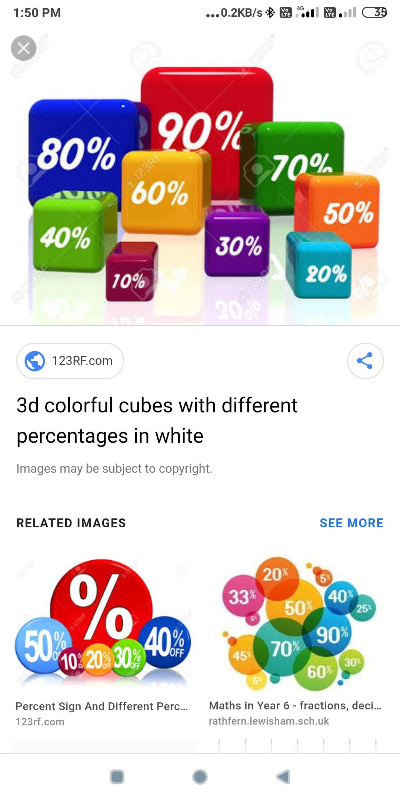
Well... Let's try some more...
What is 35% of 6000?
What is 33.33% of 270?
What is 68% of 5000?
What is 39% of 65000?
What is 62.5% of 80?
What is 12.5% of 120?

Slide 5
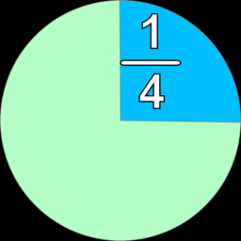
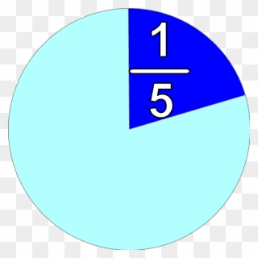
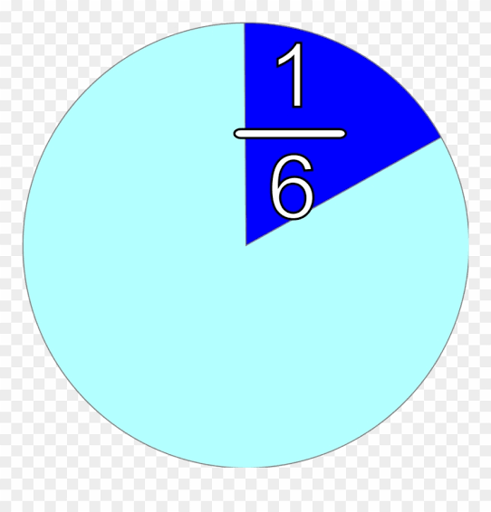
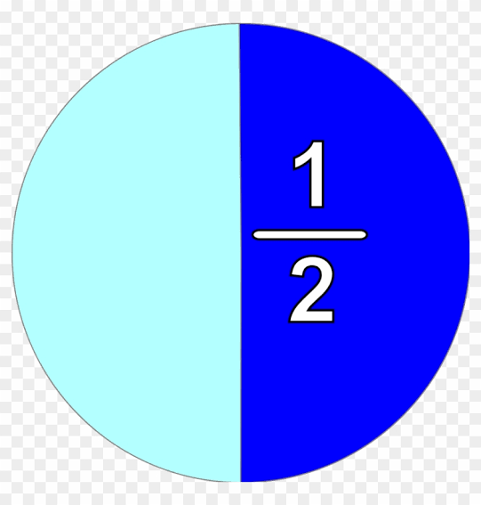




Fractions
50%
25%
20%
What percentage is this??

Slide 6
1/8 = 12.5%
1/9 = 11.11%
1/10 = 10%
1/11 = 9.09%
1/12 = 8.33%
½ = 50%
⅓= 33.33%
¼ = 25%
⅕ = 20%
⅙ = 16.66%

Slide 7
44.44% 81 = ?
27.27% 88 = ?
Let’s discuss the answer now

Slide 8
40 % 50 = ?
60 % 80 = ?
70 % 200 = ?
20 % 800 = ?

Slide 9
Calculate 25% 80 = ?
Express 5/8 in percentage form ______

Slide 10
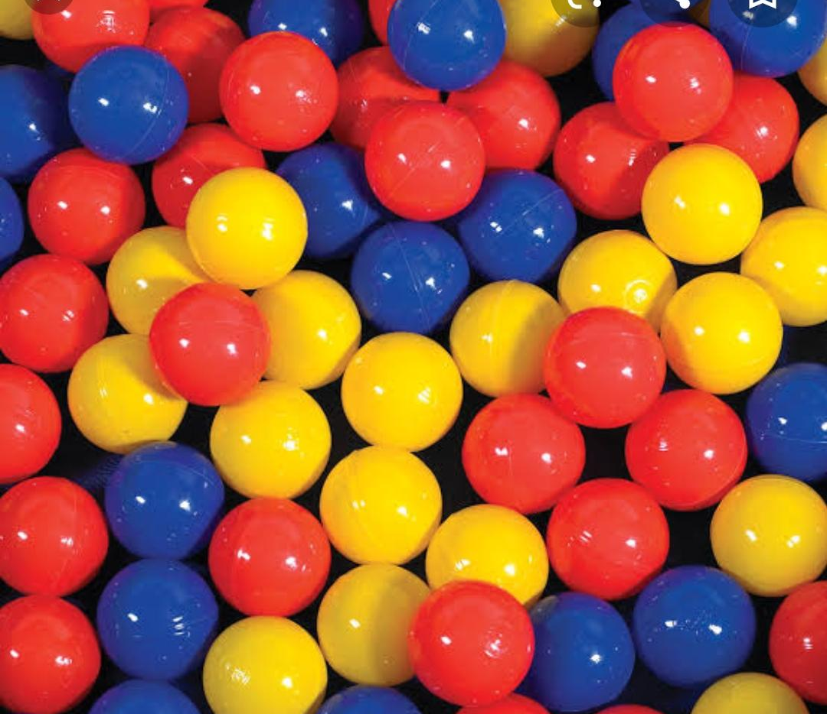
A bag has 300 balls. Out of 300 balls, 15% of balls are blue. How many blue balls are there?

Slide 11
Percentage Increase Decrease Concepts
A shopkeeper bought a shirt for Rs.1000. He thought of increasing the MRP by 25% to get profit. No one bought that shirt.
So, finally he thought of giving discount. He made a discount tag with 20%.
For how much did the shopkeeper sell the shirt?

Slide 12
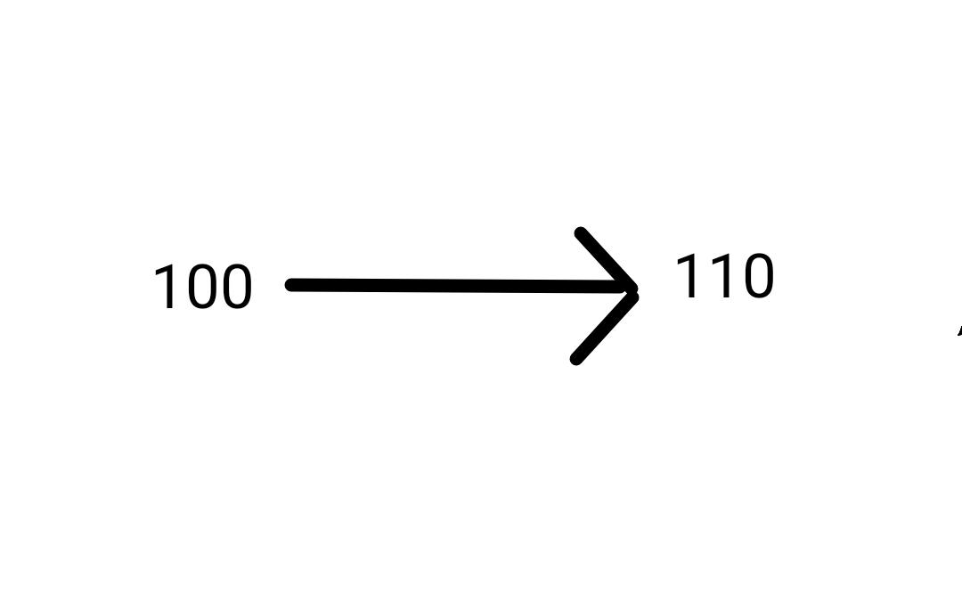
Percentage Increase Decrease Concepts
Babu has Rs.100 in his savings account. His Father gave Rs. 10.
How much percentage got increased from his initial savings?

Slide 13
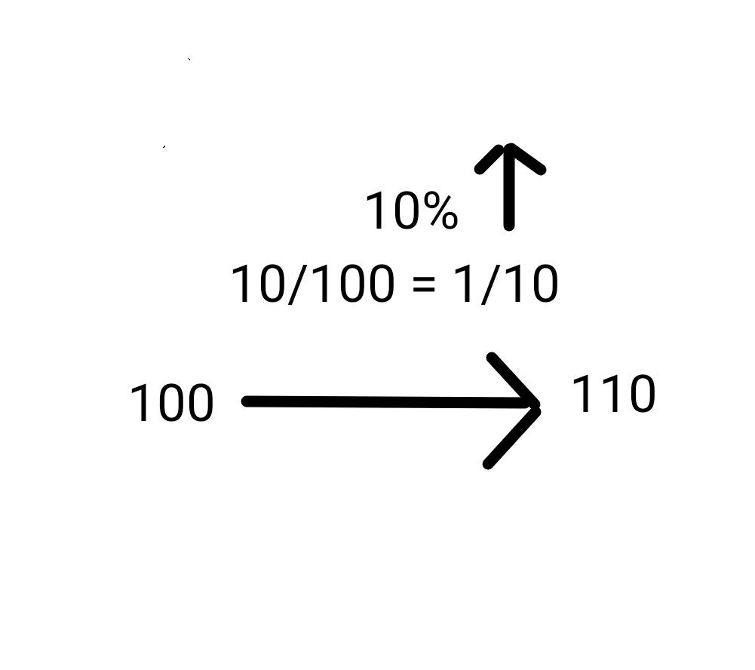
Percentage Increase Decrease Concepts
Percentage Increase = (Increased Value/ Base Value )* 100

Slide 14
Percentage Increase Decrease Concepts
Babu has given Rs.10 to his sister. Now, what is the percentage decrease in this case?
How much money got decreased?
The same?
Rs.10..
How much percentage got decreased?
The same? 10% ?

Slide 15
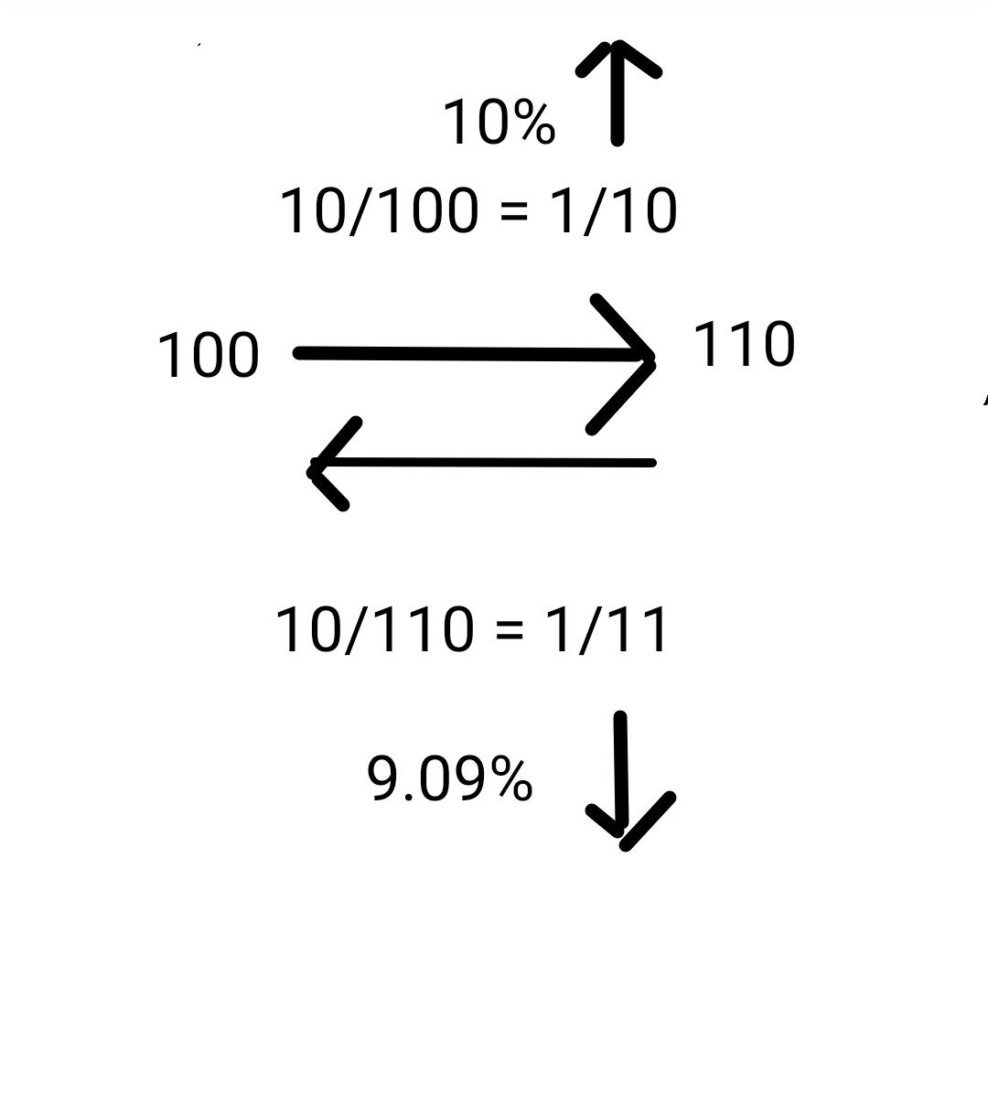
If 10% increases ,
9.09% decreases..

Slide 16
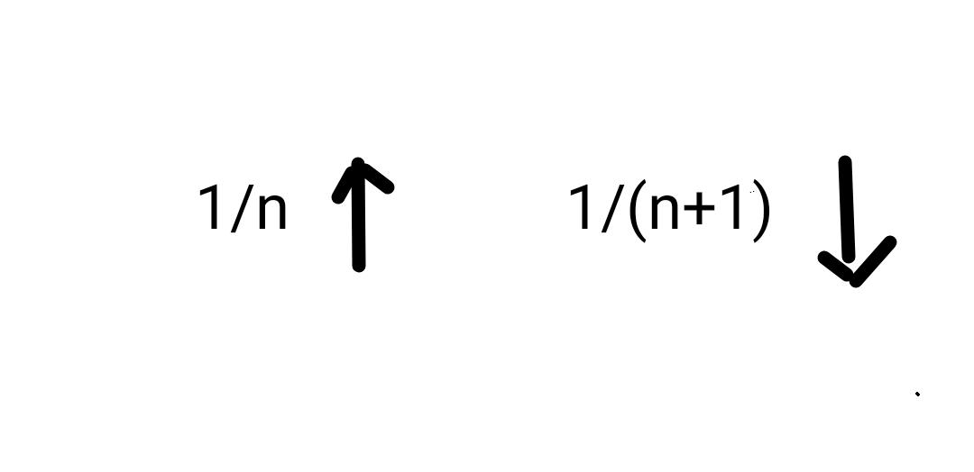
If (1/10) increases, (1/11) decreases...

Slide 17
Let's answer these questions..
If 1/5 increases ?
If 1/9 increases?
If 1/12 decreases?
If 1/6 decreases?
If 2/3 decreases?
If 4/7 decreases?
If 2/5 decreases?
If 6/7 decreases?

Slide 18
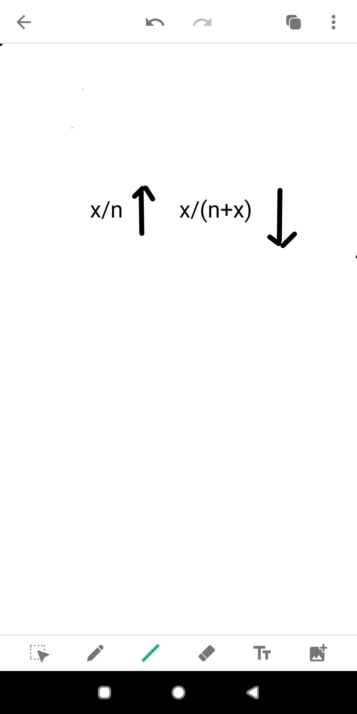
If x/n increases , x/(n+x) decreases..

Slide 19
Salary of X is 20% more than that of Y. By what percentage is the salary of Y lesser than X?
Assume salary of Y = __________
Salary of X = __________
Difference in salary = __________
Therefore, the salary of Y is lesser than that of X by ________ %

Slide 20
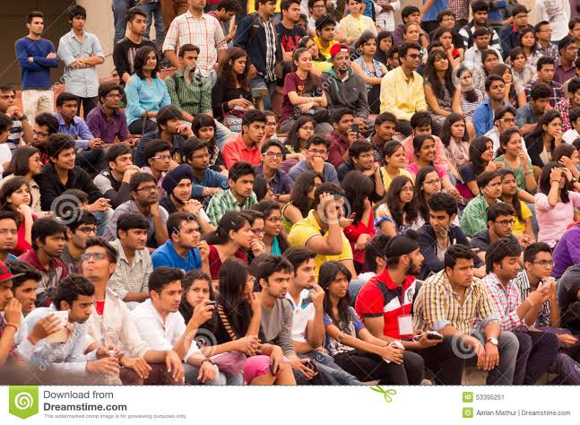
There were 1000 students in 2nd year Arts department of SRM University during 2018. During 2019, total strength of students got increased by 10%.
Due to corana, total strength of the students got decreased by 10%.
How many students are there in the arts department now?

Slide 21
Successive Increase or Decrease
Q.No 1
Arjun went to a shop and saw a shirt with 10% discount. The MRP of the shirt is Rs.1000.
Again he bargained with the shopkeeper and got another 10% discount. For how much, Arjun would have bought the shirt finally?

Slide 22
Successive Increase or Decrease can be calculated using the formula
Successive Increase
a + b + ab/100
Successive Decrease
-a - b + ab/100
Successive Increase and Decrease
a - b - ab/100
Successive Decrease and Increase
-a + b - ab/100

Slide 23


